Slide 1
In Linux there are privileged users and unprivileged. The default privileged user is “root”. This user has full access to everything on a Linux server and is allowed to work in system space without any restrictions. Be careful if you are logged as root , since each command that you type is with enough privileges. Exercises: 1. Find information on the internet about the file /etc/passwd. 2. Cat /etc/passwd and then grep for the root user. 3. What is the root user id ? Run ‘id root’ 4. Do you think it’s safe to let the root user to log in inside a server from remote ( SSH ) ?
Users and Groups

Slide 2
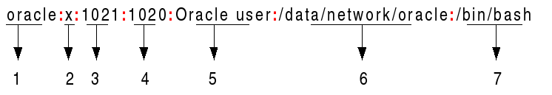
/etc/passwd => information about each user is stored there.
1 => user_name.
2 => x indicates that encrypted password is stored in /etc/shadow.
3 => user_id.
4 => group_ud.
5 => primary group.
6 => home directory.
7 => the shell that the user is using.

Slide 3

/etc/shadow => encrypted passwords of users are stored here. Linux is following the Unix tradition, to count the time from Jan, 1st 1970 ( the official Birthday of UNIX). 1. Username 2. Encrypted password. 3. Days since last password change. 4. Min number of days required between password change. 5. Max 6. Warning 7. Inactive Simple way to get this information: chage –l user_name

Slide 4
Groups in Linux: Linux users can be a member of two different kinds of groups: primary group and secondary groups. By default each user is created with primary group identical as his name. Exersises: 1. Add a user with ‘useradd user_name’. 2. Run the id command on that user. 3. In which file do you think that groups are stored ? 4. Create two groups sales and account. 5. Create users bob, betty, bill and Beatrix. 6. Make bob and betty members of the group sales, and bill and Beatrix member of the group account. 7. Set a password policy that requires users to change their password every 90 days.

Slide 5
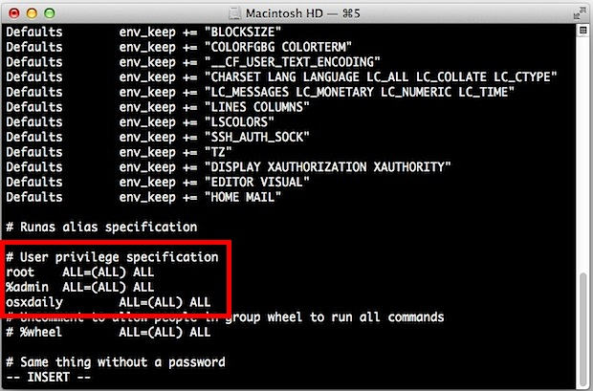
Sudo => super user do. A program that allows users to run programs with the security privileges of another user, by default the superuser(root). man visudo. Whenever you edit the sudo file /etc/sudoers, always use visudo, since it locks it for the current user. Exercise: 1. Add a local user as a sudo. 2. Run ‘sudo whoami’

Slide 6
Regular expressions => a text string that describes a particular search pattern.
^anna => lines that start with anna.
$py => files that end with py.
r[aou]t => rat, rot, rut.
Exercises:
List all users starting with ‘r’.
List all files ending in ‘sh’.

Slide 7
LDAP = Lightweight Directory Access Protocol
It manages related information from a centralized location through the use of directory hierarchy. LDAP is hierarchical tree based database. Information is stored as key-value pairs.
Example LDAP tree structure:
dc=bg
dc=softintellect
ou=students
uid=ibeli
cn=Iliya Belichev
mail=somemail@gmail.com
Homework:
Review the previos three slides + this one and think about what’s most challenging for you? Try to understand something more about it, implemented in the VM, ask me questions.

